Slide 1
Leverage the Microsoft Graph & 3rd Party APIs
Calling the Microsoft Graph

Slide 2

Calling the Microsoft Graph
Overview of the Microsoft Graph
Microsoft Graph JavaScript API
TypeScript Type Declarations
SPFx’s MSGraphClient
Notes:
In this unit, you'll learn how to incorporate Microsoft Graph into your custom SharePoint Framework solutions.

Slide 3
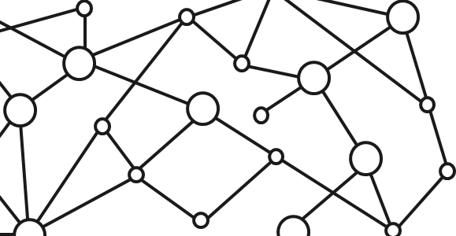
Microsoft 365 Platform
Extend Microsoft 365 experiences
web, device, and service apps
Build your experience
Documents
Pages
Conversations
Timeline
iOS/Android/Windows/Web
1
Microsoft Graph
Notes:
The Microsoft 365 developer vision focuses on the user's experience and their data and as a developer you can bring your application into the user experience with over 1.2 billion users of Office worldwide. This is a huge opportunity to provide a window into your application and to enable users to connect into their data to intelligence to your application.
There are currently over 850 million events created each month and a total of over 400 petabytes of data stored in the service that can add value for your users.
The Microsoft Graph is the gateway to your data in the Microsoft cloud as you see there.

Slide 4
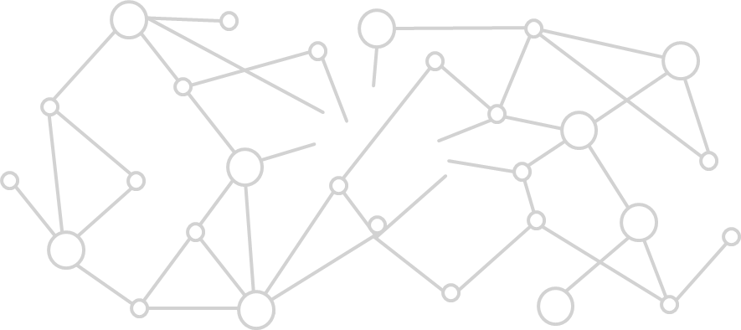
Microsoft Graph Gateway to your data in the Microsoft-cloud
https://graph.microsoft.com
Office 365
Windows 10
Enterprise Mobility + Security
Users, Groups, Organizations
Outlook
SharePoint
OneDrive
Teams
Planner
Excel
OneNote
Activities
Device Relay
Commands
Notifications
Azure AD
Intune
Identity Manager
Advanced Threat Analytics
Advanced Threat Protection
Mail, Calendar,
Contacts and Tasks
Sites and Lists
Drives and Files
Channels, Messages
Tasks and Plans
Spreadsheets
Notes, and more…
Identity Management
Access Control
Synchronization
Domains
Administrative Units
Applications and Devices
Advanced Threat Analytics
Advanced Threat Protection
Alerts
Policies
and more…
Notes:
The Microsoft cloud is included of multiple services and data types that we can take advantage of from Office 365, and it's all considered part of the Microsoft 365 platform.
Developers can integrate the signed-in user's email, calendar, contacts, and tasks into custom apps. We can work with content in SharePoint sites and lists files in OneDrive, channels and content within Microsoft Teams, and users in Azure Active Directory (Azure AD).
There are many different services that developers can take advantage of in their custom apps. Many of these services have their own APIs developers can interact with.
However, this can be challenging to go to each of these individual services with their individual endpoints. Each API may have its own permission model, which means they have individual access control configurations. Different endpoints for each service mean our custom applications will need to obtain an access token from Azure AD for each one.

Slide 5
Microsoft Graph, gateway to Office 365
Single resource that proxies multiple Microsoft services
Allows for easy traversal of objects and relationships
Simplifies token acquisition and management
Eliminates the need to traditional discovery (using “me” and “myorganization”)
Notes:
One of the benefits of Microsoft Graph is that it serves as a proxy endpoint to all of these other services. Microsoft Graph encompass things such as Office 365, Windows 10 enterprise mobility and security (EMS), and it brings all of these different services under one unified endpoint: **graph.microsoft.com**.
The advantage to using Microsoft Graph is that it allows developers to just have a single endpoint, a resource, which means you're only going to need a single access token authenticate the different services. Each service still has its own individual permissions so that everything is still secured in an individual way. A single endpoint makes it easier for developers to build applications.
Microsoft Graph also enables easy navigation of entities and the relationships between entities. While there are many different Microsoft 365 services such as OneDrive for files, or Outlook for contacts and calendars, these different entities are related to each other. These relationships are in Microsoft Graph, which makes it easy to navigate from one entity to another, even if it crosses different underlying endpoints.

Slide 6
Microsoft Graph JavaScript SDK
Microsoft Graph is accessible via REST API & various SDKs
Client-side solutions can leverage the JavaScript SDK
https://github.com/microsoftgraph/msgraph-sdk-javascript
Requires initialization with an Azure AD provided OAuth2 access token to create the client
Notes:
Microsoft Graph is accessible as a REST API so developers can use any technology that supports submitting and processing an HTTP request to an endpoint. Microsoft also offers many different SDKs for Microsoft Graph for different platforms and technologies to improve developer productivity.
One of the options offered by Microsoft is the [Microsoft Graph JavaScript SDK](https://github.com/microsoftgraph/msgraph-sdk-javascript). After initializing the SDK with an OAuth 2.0 access token, you can use the SDK to submit requests to Microsoft Graph. The SDK communicates directly with the Microsoft Graph REST API and returns the results as well known objects. Microsoft also provides TypeScript type declarations for the SDK for TypeScript-based projects.

Slide 7
Initializing the Microsoft Graph JS SDK
var client = MicrosoftGraph.Client.init({
authProvider: (done) => {
done(null, access_token);
}
});
client
.api('me')
.get((err, res) => {
console.log(res);
});
Notes:
To use the JavaScript SDK, you must first initialize it. This is done by setting the OAuth 2.0 access token before you submit any requests to Microsoft Graph.
Initialize the Microsoft Graph JavaScript SDK by calling the `init()` method and pass in an object with an `authProvider` implementation. The `authProvider` function contains one argument, a callback, that you call with two arguments. The second argument should be the access token.
Once the Microsoft Graph client is initialized, you can submit requests to Microsoft Graph endpoints using the `api()` method. The JavaScript SDK is a fluent API, which means you can chain multiple methods together. For instance, to get the current user's information, you can call the `get()` method after calling the `api()` method.

Slide 8
Microsoft Graph TypeScript Type Declarations
Use the Microsoft Graph JavaScript SDK in TypeScript applications
TypeScript type declarations introduce strong types and documentation to client-side projects
https://github.com/microsoftgraph/msgraph-typescript-typings
Notes:
While the Microsoft Graph JavaScript SDK is written in JavaScript, just like other libraries, you can use it in TypeScript applications including SharePoint Framework projects. Once the [Microsoft Graph TypeScript Type Definitions](https://github.com/microsoftgraph/msgraph-typescript-typings) are installed in TypeScript-based projects, you can then import relevant objects into your TypeScript files.

Slide 9
Microsoft Graph TypeScript Type Declarations
import * as MicrosoftGraph from '@microsoft/microsoft-graph-types';
// init Microsoft Graph client
client
.api('/me')
.get((error: any, user: MicrosoftGraph.User, rawResponse?: any) => {
console.log('name: ', user.displayName);
console.log('email: ', user.mail);
console.log('phone: ', user.businessPhones[0]);
});
});
Notes:
Install the Microsoft Graph TypeScript type declarations by executing the following statement on the command line:
```shell
npm install @microsoft/microsoft-graph-types --save-dev
```
Once installed, you can then use the types in your projects:

Slide 10
SharePoint Framework Includes a Microsoft Graph Client
MSGraphClientV3: SharePoint Framework’s Microsoft Graph Client
Abstracts the token acquisition from the SharePoint Framework’s support for Azure AD
Wraps the Microsoft Graph JavaScript SDK and initializes it with one line that returns a promise
this.context.msGraphClientFactory
.getClient('3')
.then((client: MSGraphClientV3): void => {
// use MSGraphClientV3 here
});
Notes:
You can use Microsoft Graph in your custom SharePoint Framework solutions. Microsoft Graph is a service that is secured with Azure AD. The SharePoint Framework leverages the same infrastructure for requesting and granting permissions to Azure AD secured APIs as it does for custom Azure AD secured APIs. The unit on **Call Azure AD secured third-party REST APIs** explains how the SharePoint Framework API can be used to call Azure AD secured endpoints.
The SharePoint Framework API includes the Microsoft Graph JavaScript SDK and also handles the initialization of the client. This is handled using the existing Azure Ad support to obtain an access token.
To obtain an instance of the Microsoft Graph JavaScript SDK, use the `this.context.msGraphClientFactory.getClient()` method. This will return an instance of the `MSGraphClientV3` that is already configured with the necessary OAuth 2.0 access token:

Slide 11
SPFx Solutions Declare Permission Requests
// package-solution.json
{
"$schema": "https://developer.microsoft.com/json-schemas/spfx-build/package-solution.schema.json",
"solution": {
"name": "ms-graph-sp-fx-client-side-solution",
"id": "dfb230b7-4f61-431f-9b65-a34e83922663",
"version": "1.0.0.0",
"includeClientSideAssets": true,
"isDomainIsolated": false,
"webApiPermissionRequests": [
{ "resource": "Microsoft Graph", "scope": "User.ReadBasic.All” },
{ "resource": "Microsoft Graph", "scope": "Calendars.Read” },
{ "resource": "Microsoft Graph", "scope": "Tasks.Read” }
]
},
"paths": {
"zippedPackage": "solution/ms-graph-sp-fx.sppkg"
}
}
Notes:
Because Microsoft Graph is an Azure AD secured API, you will need to request a permission to Microsoft Graph when a SharePoint Framework package is deployed to the App Catalog. Do this using the `webApiPermissionRequests` array in the **package-solution.json** configuration file in a project.
Each request must include the name of the REST API (`resource`) and the permission (`scope`) requested:

Slide 12
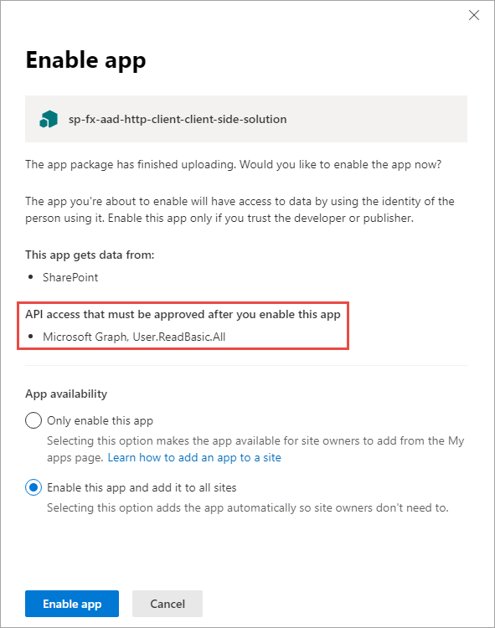
Add SharePoint Package to SharePoint App Catalog
Upload SharePoint packages to the app catalog
Enable app panel contains information about API access (permission) requests
While application can be installed in SharePoint sites, it does not have the permissions granted that it needs to access Azure AD protected resources
Notes:
When an administrator deploys the SharePoint Framework component to the tenant App Catalog, they're presented with information about API access requests in the Enable app panel:
This section of the panel lists the API access requests that should be reviewed and approved or rejected. Recall that API access requests aren't tied to the SharePoint Framework package. Approving or rejecting the API access requests is a separate step that must be done in order for the SharePoint Framework component to work.

Slide 13
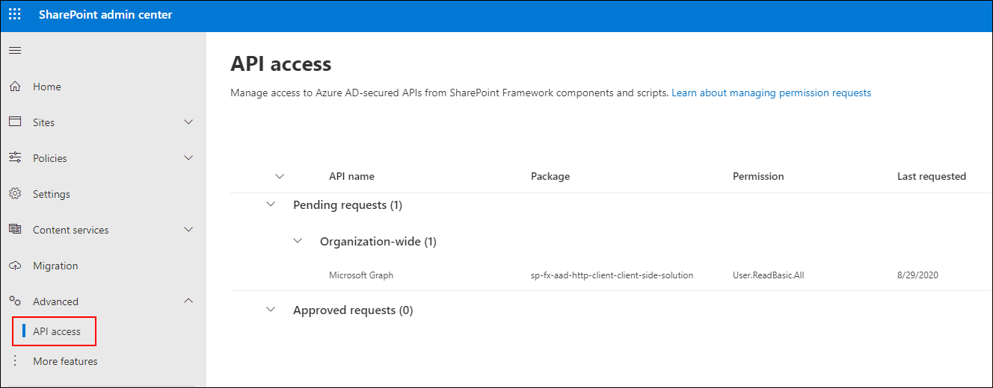
Approve / Reject with SharePoint Online API Management Page
Notes:
To approve or reject API access requests, navigate to the API access page in the SharePoint Admin Center. Here you'll find a list of API access requests pending approval or rejection:

Slide 14
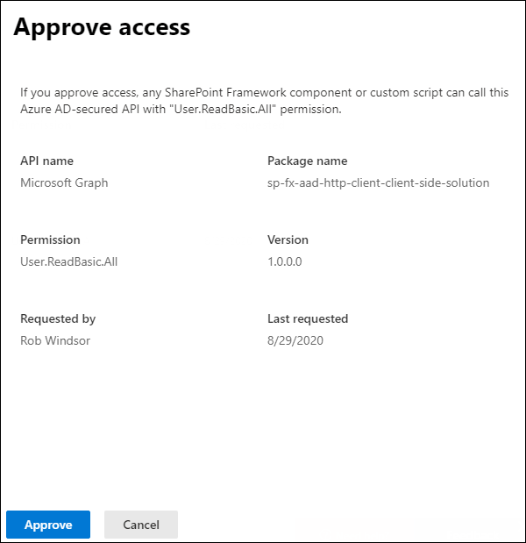
Approve / Reject with SharePoint Online API Management Page
Notes:
Select the API access request to view its details and use the buttons at the bottom of the panel to approve or reject the request:

Slide 15
Demo Calling the Microsoft Graph

Slide 16

Summary
Overview of the Microsoft Graph
Microsoft Graph JavaScript API
TypeScript Type Declarations
SPFx’s MSGraphClient

Slide 17
Reading further
Overview of the SharePoint Framework
https://learn.microsoft.com/en-us/sharepoint/dev/spfx/sharepoint-framework-overview
Use the MSGraphClientV3 to Connect to Microsoft Graph
https://learn.microsoft.com/sharepoint/dev/spfx/use-msgraph

Slide 18
Thank you.

